Slide 1
Inventra – Intelligent Inventory Management System
-Romen Halder

Slide 2
Problem Statement:-
Small businesses struggle to manage stock accurately, leading to overstocking, stockouts, and manual calculation errors.
They often face difficulties in tracking product movements, managing users securely, and maintaining proper purchase and sales records
Generating accurate reports for audits, business decisions, and financial planning becomes time-consuming and inefficient without a digital system.

Slide 3
Existing Problem
Many small businesses still manage inventory manually using registers or Excel sheets, which leads to errors and confusion.
There is no real-time stock tracking, so businesses often face stock shortages or excess inventory.
Lack of proper reporting and user control makes it difficult to monitor sales, purchases, and employee activities efficiently.

Slide 4
Bakery Inventory Management System
A comprehensive full-stack inventory management solution designed specifically for bakeries to track products, manage stock levels, monitor expiration dates, and generate alerts for low stock or expiring items.
Core Features:-
Product Management & Inventory Tracking The system allows managing bakery products (finished goods and raw materials), with categories, image upload, stock limits, and expiry tracking.
Smart Alert System:
The system includes a smart alert system that automatically sends notifications for low stock, out-of-stock items, reorder points, expiring products (within 7 days), and expired products.

Slide 5
User Management: The system provides role-based access control with Admin and Employee roles, secure JWT authentication, OTP verification, and password reset functionality.
Reporting & Analytics: It generates stock reports, transaction history, low stock summaries, and tracks user activities for better business monitoring.

Slide 6
Tech Stack
Backend:-
Framework: Spring Boot 3.1.6
Language: Java 17
Security: Spring Security with JWT
Database: MySQL 8.0
ORM: Hibernate / JPA
Build Tool: Maven
Additional Libraries:
Lombok
JJWT
Jakarta Validation
Frontend:-
Framework: React 19
Build Tool: Vite
State Management: Redux Toolkit
Styling: Tailwind CSS 4

Slide 7
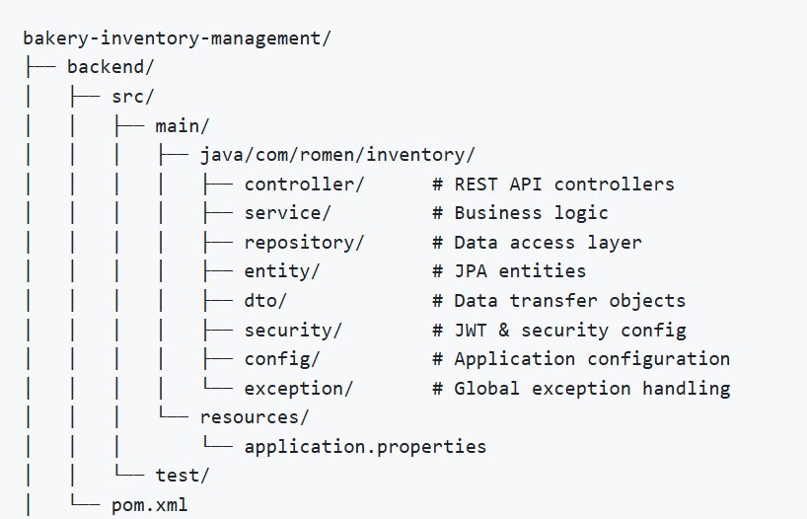
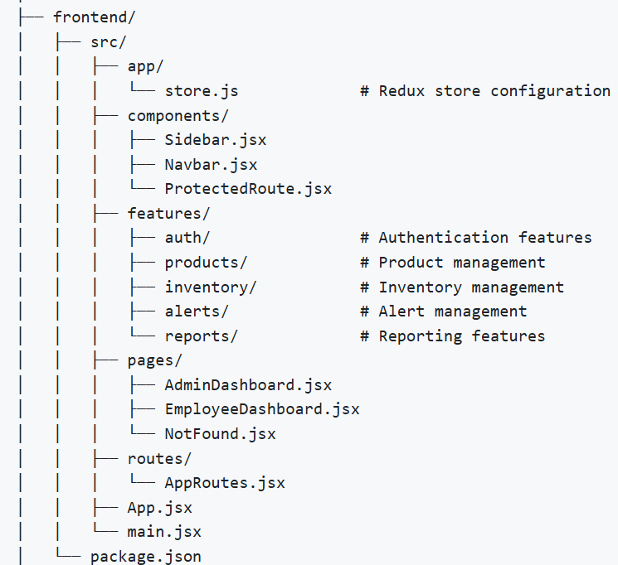
Project Structure
Backend
FrontEnd

Slide 8
Module 1: User Authentication & Role Management
This module manages secure login and role-based access control in the system.
Admin Control: Admin can create new users and activate or deactivate accounts. If a user is marked as inactive, they cannot log in until reactivated by the admin.
Role-Based Access: Admin has full system control, while Employees have limited permissions based on their role.
Security Features: Secure login with JWT authentication and password encryption to prevent unauthorized access.

Slide 9

Pseudocode
AuthController – Signup
CLASS AuthController
FUNCTION signup(request)
userDetails = request data
result = AuthService.registerUser(userDetails)
RETURN result
END FUNCTION
END CLASS
AuthService – Signup Logic
CLASS AuthService
FUNCTION registerUser(userDetails)
existingUser = UserRepository.findByUsername(userDetails.username)
IF existingUser exists THEN
RETURN "User already exists"
END IF
encryptedPassword = encrypt(userDetails.password)
newUser = create User
newUser.username = userDetails.username
newUser.password = encryptedPassword
newUser.role = userDetails.role
newUser.email = userDetails.email
UserRepository.save(newUser)
RETURN "Signup successful“
END FUNCTION
END CLASS
Authrepository

Slide 10
Verifies username,
Verifies password , Generates JWT token
AuthController – Signin
CLASS AuthController
FUNCTION signin(request)
username = request.username
password = request.password
token = AuthService.authenticate(username, password)
RETURN token
END FUNCTION
END CLASS
AuthService – Signin Logic
CLASS AuthService
FUNCTION authenticate(username, password)
user = UserRepository.findByUsername(username)
IF user does not exist THEN
RETURN "Invalid username"
END IF
IF password matches encrypted password THEN
token = JWTUtility.generateToken(user)
RETURN token
ELSE
RETURN "Invalid password"
END IF
END FUNCTION
END CLASS
Authrepository

Slide 11
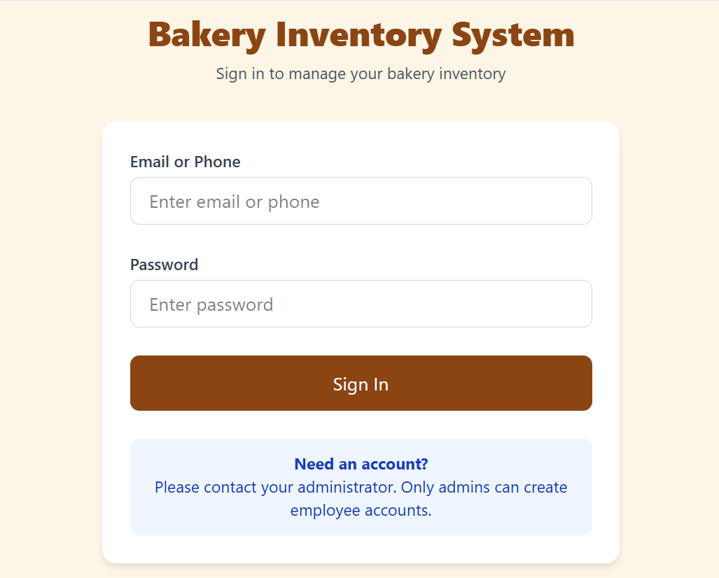
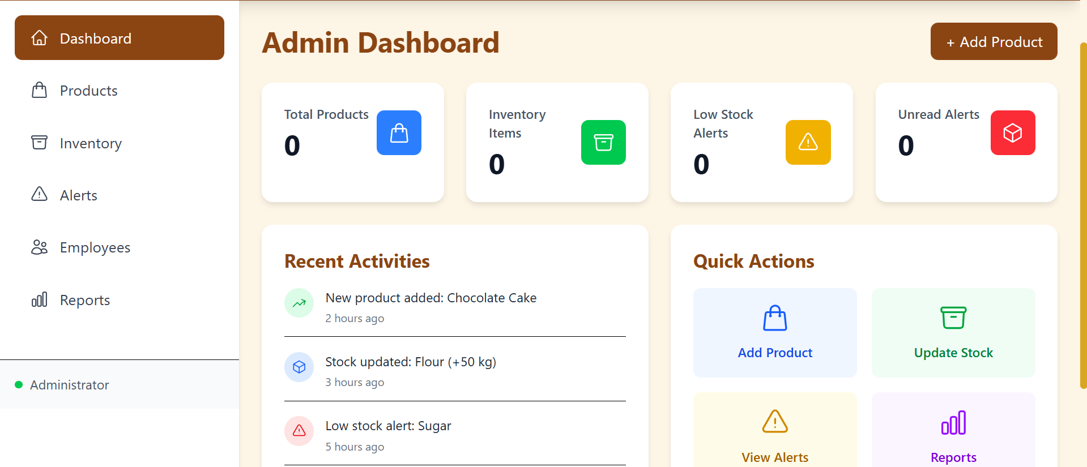
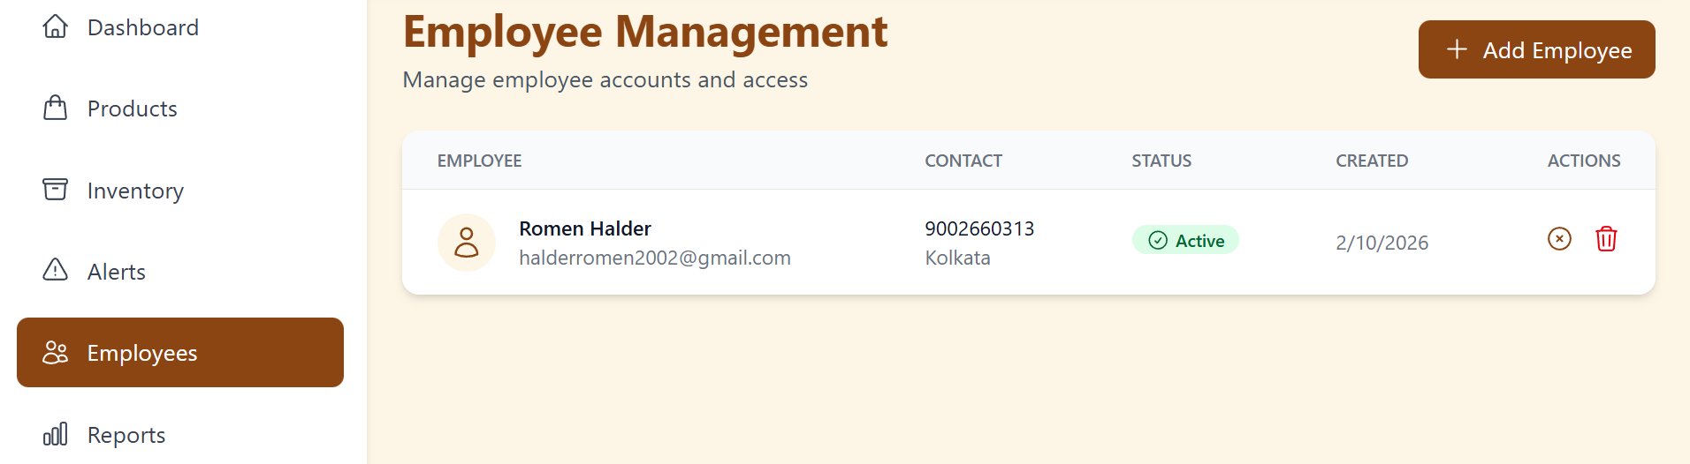
Login Page
Only admin add and manage user

Slide 12
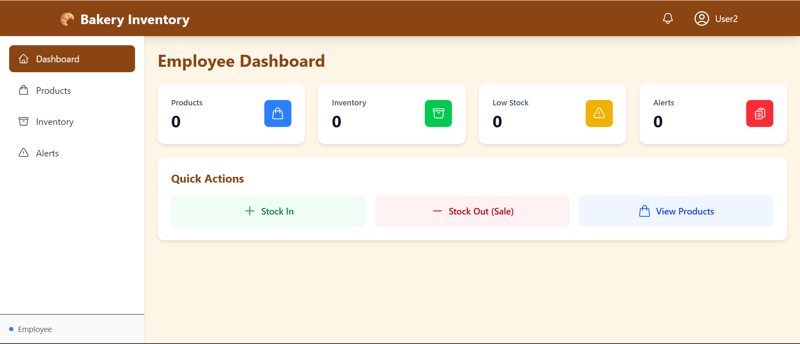

Slide 13
Conclusion
The authentication module ensures secure and controlled access to the Inventra system by using role-based login, JWT authentication, and account status management. Admin can create, activate, or deactivate users, ensuring proper system control. This module improves security, accountability, and smooth user management in the inventory system.

Slide 14
Thank You

